Slide 1

⁠Predicting Power Consumption of Hydraulic Presses
Naan Mudhalvan
Nishanthi - 2023108049
Mathesh - 2023108050
Surya Kiran - 2023108051
Samyuktha - 2023108052
Dilip Adhitya - 2023108053
-

Slide 2

Problem Statement
The task is to Estimate power usage per operation cycle.
We aim to Predict using material thickness, pressure, tooling type and other operational data.
The dataset for this project contains more than 500 records.

Slide 3
Charts from Data Analysis

Slide 4
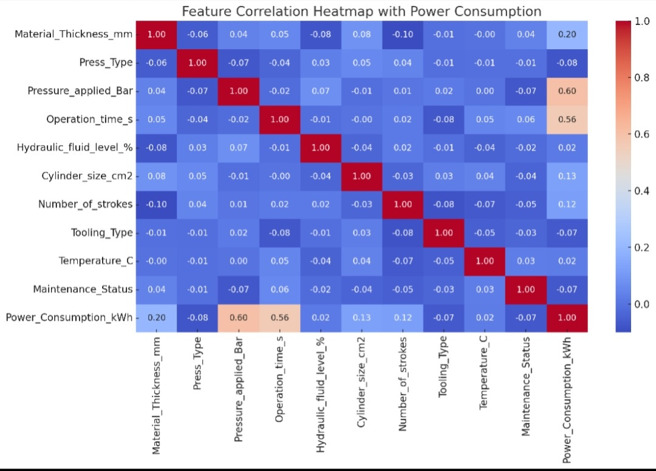
Heatmap: Correlation between numeric features

Slide 5
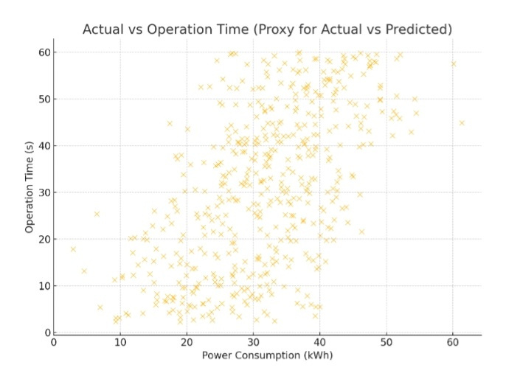
Scatterplot:
Operation time vs
power Consumption

Slide 6
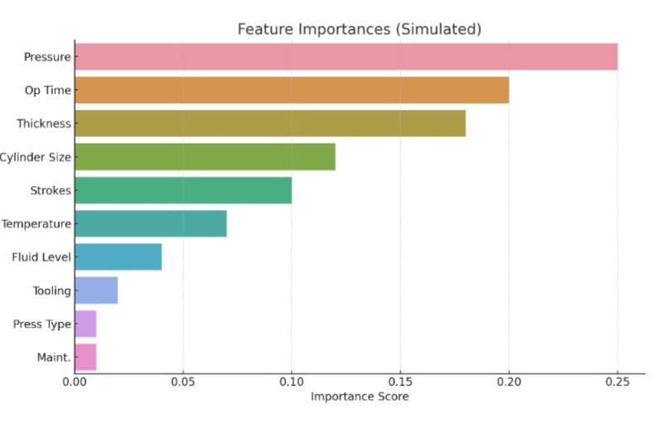
Barplot:
Importance of
components

Slide 7
Linear Regression: Performed best (R² ≈ 0.66), indicating that the relationships between inputs and power usage are largely linear.
Random Forest Regressor: Nearly matched linear regression (R² ≈ 0.66), suggesting minimal nonlinear gain.
Gradient Boosting Regressor: Slightly lower than the others (R² ≈ 0.65), likely due to the synthetic nature and limited complexity of the dataset.
Algorithms Used for Data Analysis

Slide 8
Best Model Selection
Best Model: Linear Regression
Why Linear Regression?
The dataset had minimal nonlinear interactions or complexities for tree-based models to exploit, and the added noise was purely random rather than patterned, making simple models like Linear Regression more effective, interpretable, and robust in capturing the core trend without overfitting.

Slide 9
Key advantages of Linear Regression:
1. Simplicity & Interpretability: Easy to implement and understand, with clear coefficients showing the impact of each feature on the target.
2. Efficiency: Fast to train and predict, even on large datasets with many features.
3. Baseline Performance: Serves as a strong benchmark model; often performs well when data relationships are linear or near-linear.
4. Low Overfitting Risk: With proper assumptions and regularization, it generalizes well, especially on clean, noise-free datasets
Benefits of Linear
Regression

Slide 10
Questions and Answers

Slide 11
Thank You

